Slide 1
Version Control Systems
SWE206
Sourced from the following Pro Git

Slide 2
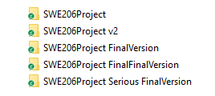
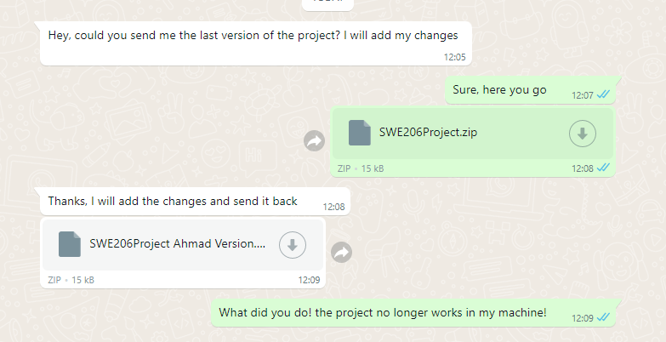
The problem

Slide 3
Version Control System
Version control is a system that records changes to a file or set of files over time so that you can recall specific versions later. (Pro Git)
Local Version Control
Centralized Version Control
Distributed Version Control

Slide 4

Local Version Control System
Pro Git

Slide 5
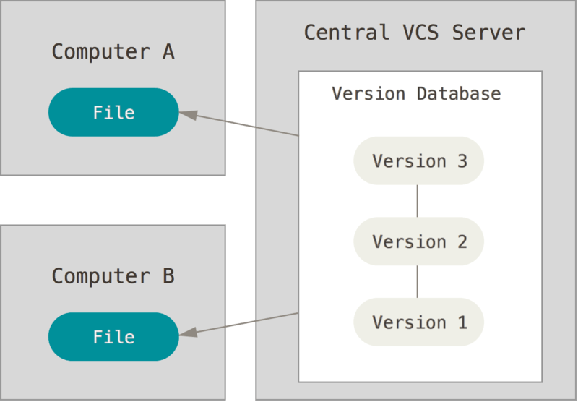
Centralized Version Control System
Pro Git

Slide 6
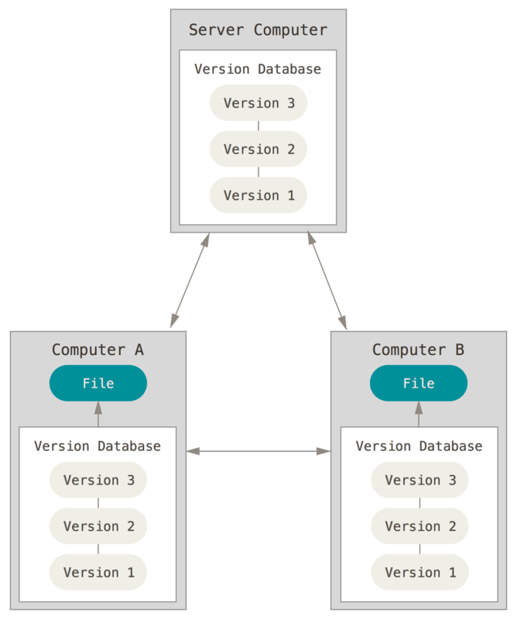
Distributed Version Control System
Pro Git

Slide 7
Git

Slide 8
Git Basic commands
Command | Description
git help <command> | get help for a git command
git init | creates a new git repo, with data stored in the .git directory
git status | tells you what’s going on
git add <filename> | adds files to staging area
git commit | creates a new commit
git log | shows a flattened log of history
git log --all --graph --decorate | visualizes history as a DAG
git diff <filename> | show changes you made relative to the staging area
git diff <revision> <filename> | shows differences in a file between snapshots
git checkout <revision> | updates HEAD and current branch

Slide 9
Git Branching commands
Command | Description
git branch | shows branches
git branch <name> | creates a branch
git checkout -b <name> | creates a branch and switches to it
git merge <revision> | merges into current branch
git mergetool | use a fancy tool to help resolve merge conflicts
git rebase | rebase set of patches onto a new base

Slide 10
Git Remote commands
Command |  | Description
git remote | list remotes
git remote add <name> <url> | add a remote
git push <remote> <local branch>:<remote branch> | send objects to remote, and update remote reference
git branch --set-upstream-to=<remote>/<remote branch> | set up correspondence between local and remote branch
git fetch | retrieve objects/references from a remote
git pull | same as git fetch; git merge
git clone | download repository from remote

Slide 11
Git Undo commands
Command | Description
git commit --amend | edit a commit’s contents/message
git reset HEAD <file> | unstage a file
git checkout -- <file> | discard changes

Slide 12
Git Advanced commands
Command | Description
git config | Git is highly customizable
git clone --depth=1 | shallow clone, without entire version history
git add -p | interactive staging
git rebase -i | interactive rebasing
git blame | show who last edited which line
git stash | temporarily remove modifications to working directory
git bisect | binary search history (e.g. for regressions)
.gitignore | specify intentionally untracked files to ignore

Slide 13


Git Tools
CI/CD
Marketplace/Addons for git server provider

Slide 14
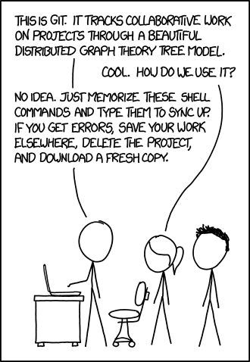
Before we finish
xkcd

